Slide 1
12 Tips for Being On-Camera

Slide 2
Agenda
Preparation
Engaging with the Camera
Speaking
When You Mess Up

Slide 3
Preparation

Slide 4
1. Practice
Write a script and memorize it
Repeat it in front of a mirror
Actually repeat it in front of a mirror
Don’t worry about sounding stilted

Slide 5
2. Use a Cheat Sheet
Presentation Outline
Challenges with video
Too hard to record
Too hard to share
Impossible to search
Overcoming with Panopto
Simple recording software
Automatic sharing
Search inside video
Product demo
Record video presentation
Show built-in sharing
Search the video
…
Create an outline of your talking points
Write in big legible text
One line per bullet
Tape the cheat sheet to your desk…
…or below the camera

Slide 6
3. Have a Drink (of Water)
Nervousness causes dry-mouth
Drink a bit of water before recording
Keep a bottle on hand between takes

Slide 7
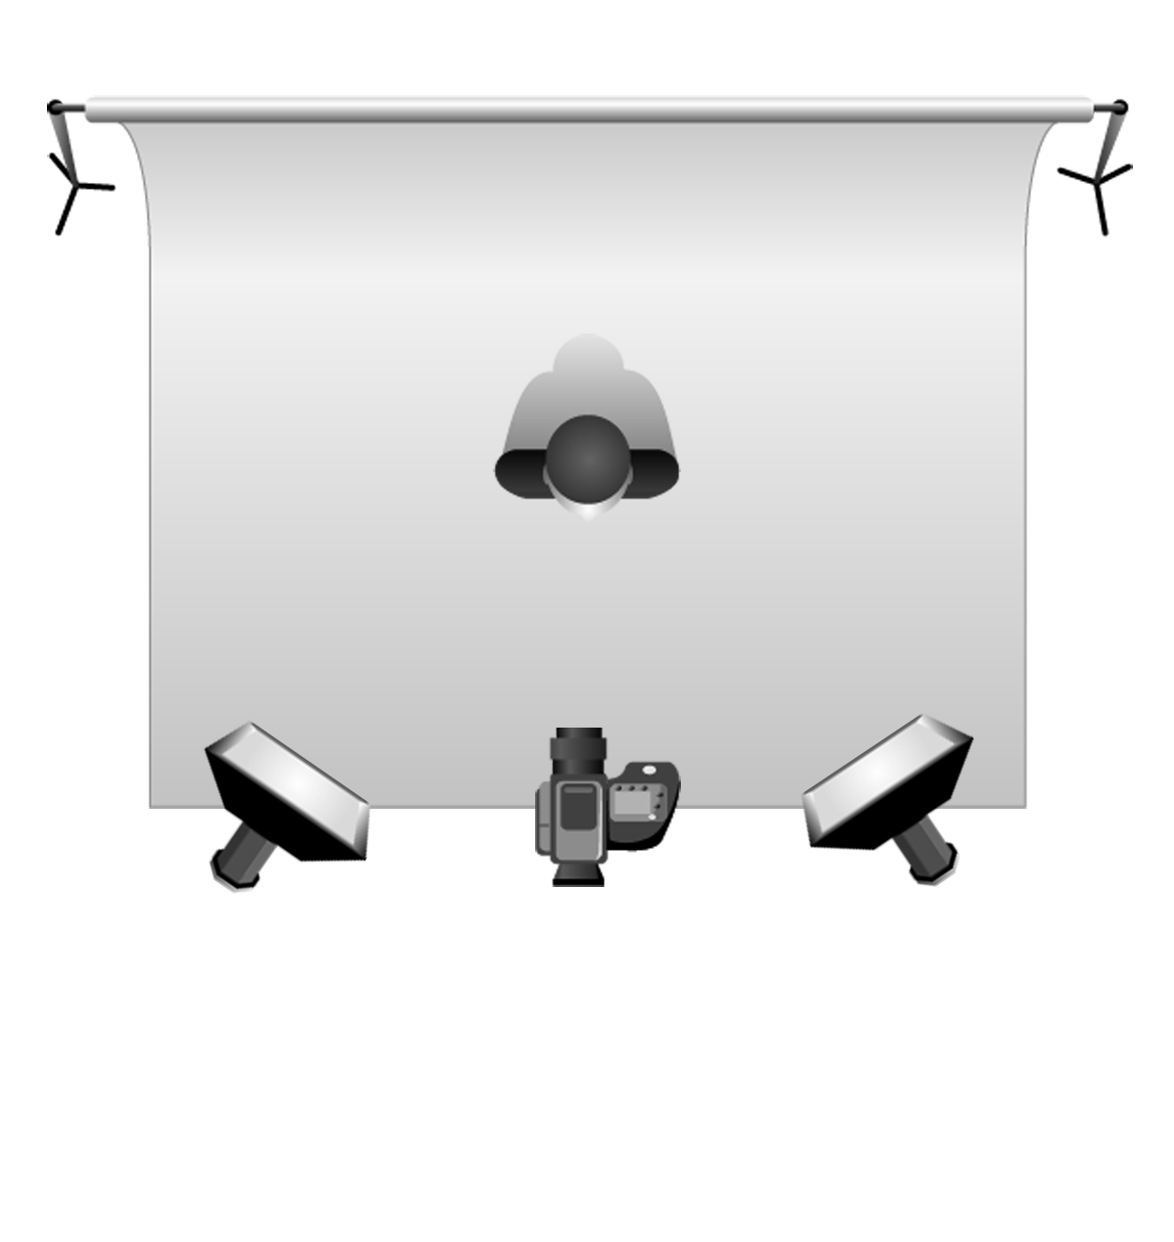
4. Set Up Your Lighting
Single Light
Two-Light
Place the light behind or
just above the camera.
Place each light to the
side of the camera, angled in.

Slide 8
4. Set Up Your Lighting (continued)
Only natural light
Window
Face the window, placing the camera
between you and the window

Slide 9
5. Progressive Muscle Relaxation (Really…Try It)
PMR involves tensing, then relaxing, muscles
It has been used as a relaxation technique since the 1920s
PMR just prior to recording can ease tension and nervousness

Slide 10
Engaging with the Camera (or not)

Slide 11
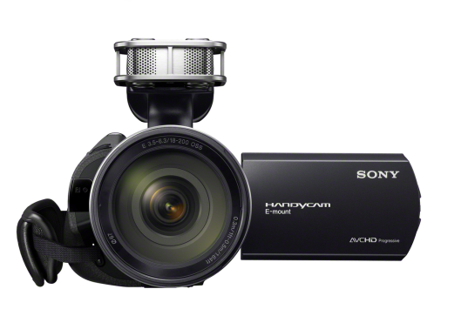
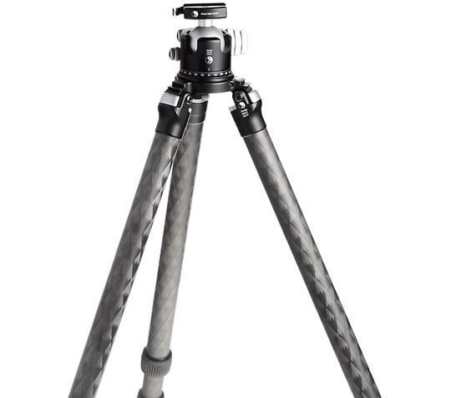
6. Pretend to Talk to a Friend
Staring down the barrel of the camera feels unnatural and can make us nervous.
One technique for overcoming “barrel terror” is to imagine the camera isn’t a camera.
Instead, imagine the camera is a close friend, family member, or even a pet.
vs.

Slide 12
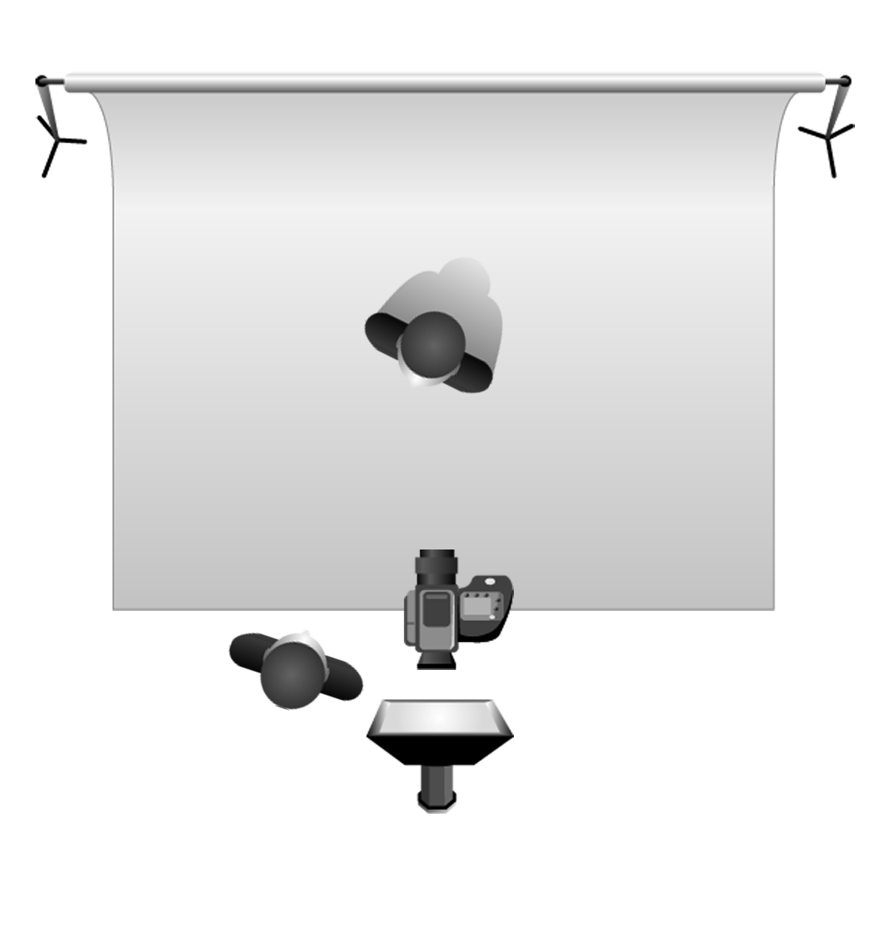
7. Actually Talk to a Friend
You don’t actually need to look into the camera
Instead, grab a friend or co-worker
Position them as close to the camera as possible
Present to them as though you were having a chat
You
Your
Friend

Slide 13
8. Reference Your Notes
Presentation Outline
Challenges with video
Too hard to record
Too hard to share
Impossible to search
Overcoming with Panopto
Simple recording software
Automatic sharing
Search inside video
Product demo
Record video presentation
Show built-in sharing
Search the video
…
Remember that cheat sheet?
It’s okay to look at it during your recording.
Really.

Slide 14
Speaking

Slide 15
9. Just Be Yourself
People will tell you to be “energetic”, “engaging”, “upbeat…”
Ignore them.
The most important thing is to be genuine.

Slide 16
10. Stop Between Sentences.
Pause.
Breathe.
Now move on.

Slide 17
When You Mess Up

Slide 18
11. Just Keep Talking
Remember that you’re your own worst critic.
Most people won’t notice the little mistakes.
If they do, they’ll empathize because they’ve probably been there.
We’re all nervous on camera and are more prone to little mistakes.
So if you make one, smile, pause, and then just keep talking.

Slide 19
12. Record a Single Take
Then just trim out the parts you don’t like with Panopto’s editor
Record in bite-sized chunks if you’d like

